Slide 1
Economic Outlook
EconoSummit 2019
Las Vegas, NV
March 24, 2019
William Strauss
Senior Economist
and Economic Advisor
Federal Reserve Bank of Chicago

Slide 2
What I said last year
The outlook is for the U.S. economy to expand at a pace
somewhat above trend in 2018
Employment is expected to rise moderately with the
unemployment rate remaining very low
Inflation is forecast rise to the Fed’s Inflation target
Housing is predicted to improve at a modest pace
Vehicle sales are anticipated to edge lower
Investment is forecast to increase at a strong pace
Manufacturing output is expected to increase at a rate
just below trend in 2018

Slide 3
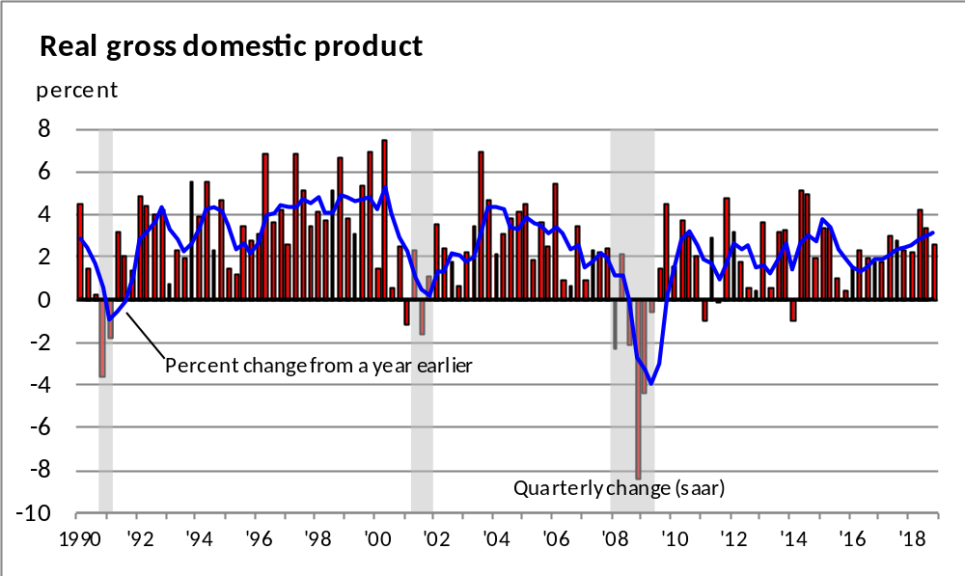
GDP expanded by 3.1% in 2018

Slide 4
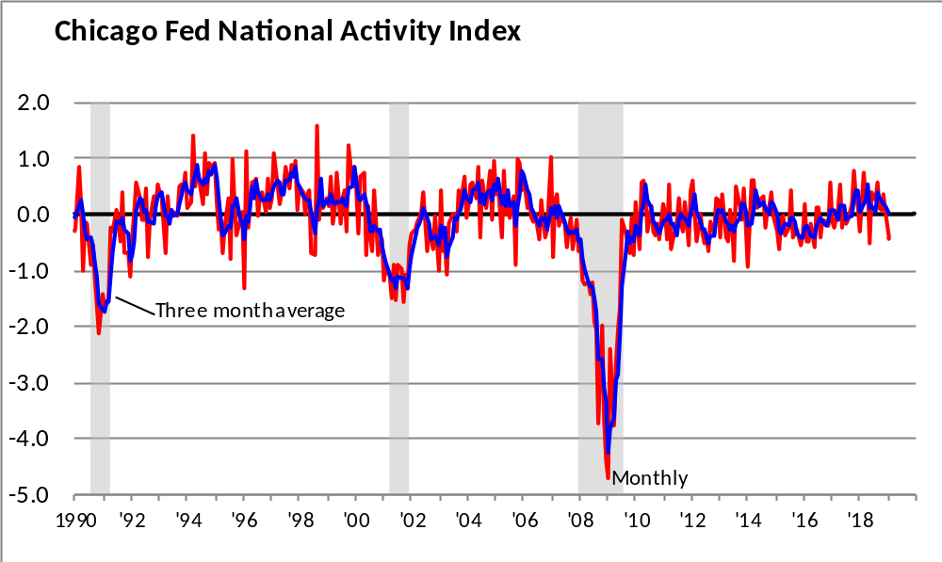
The Chicago Fed National Activity Index
3-month average in January 2019 is at trend

Slide 5
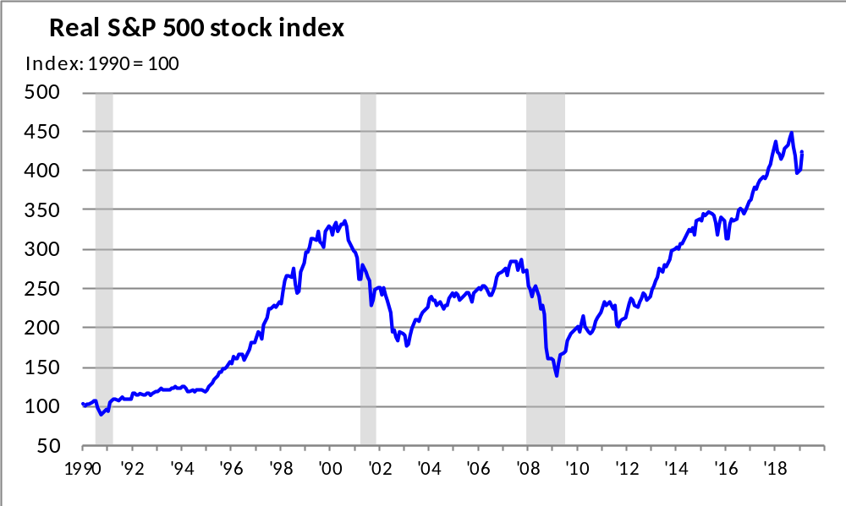
The real value of the stock market fell slightly more than 4% over the past several months but remains high

Slide 6
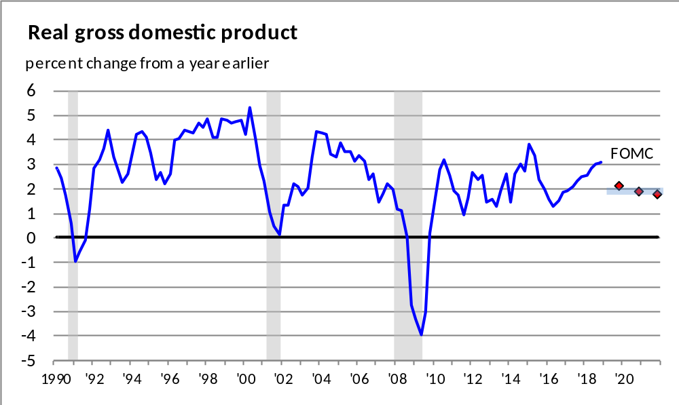
The Federal Open Market Committee (FOMC) expects
GDP to grow just above trend in 2019; and around trend in 2020 and 2021
FOMC Central Tendency (March 2019)
2019 1.9 – 2.2
2020 1.8 – 2.0
2021 1.7 – 2.0
Longer run 1.8 – 2.0

Slide 7
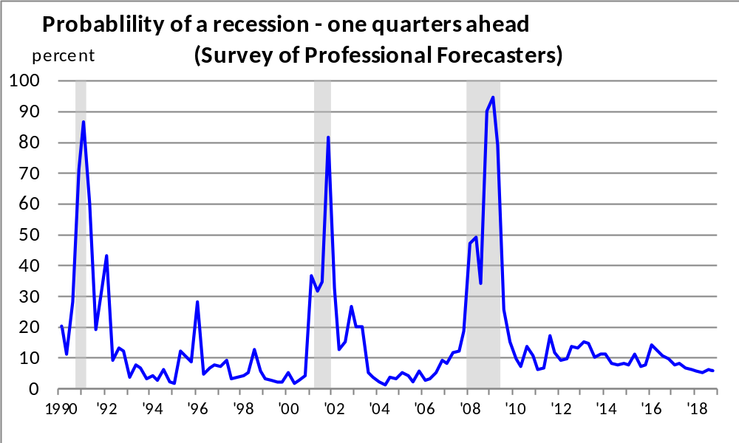
The probability of recession in the next quarter remains low

Slide 8
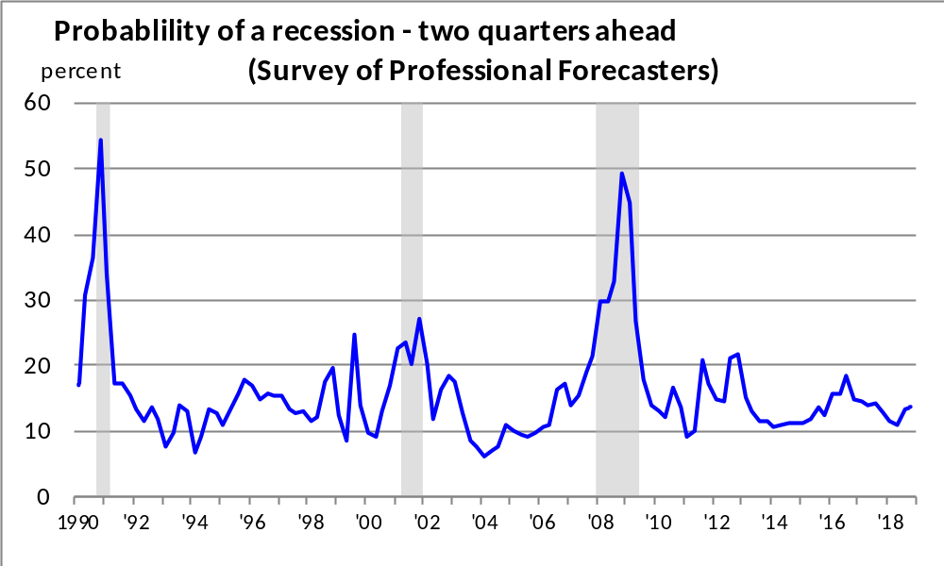
The same is true for the chances of a recession over the next two quarters

Slide 9
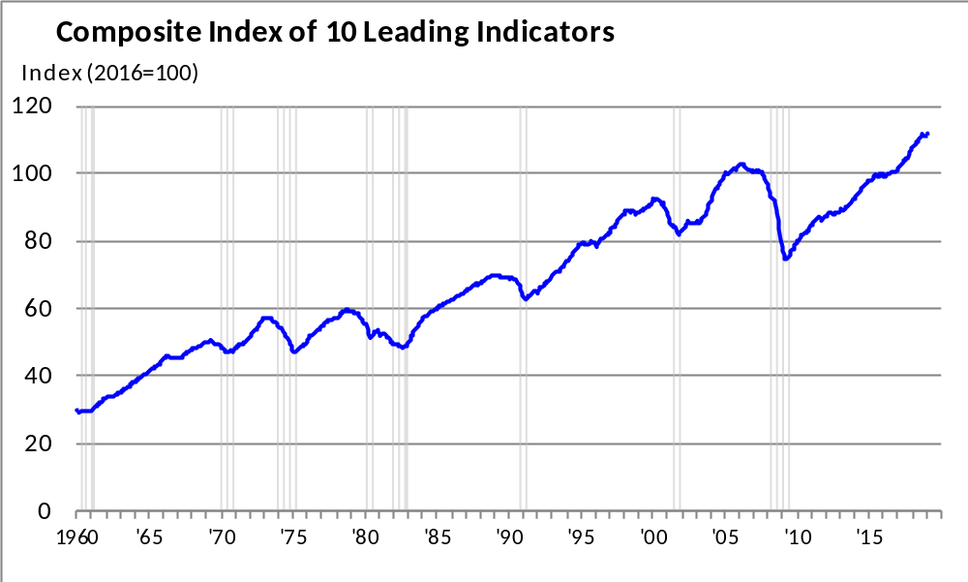
While the Index of Leading Economic Indicators moved higher in February, it has been flat for the past five months

Slide 10
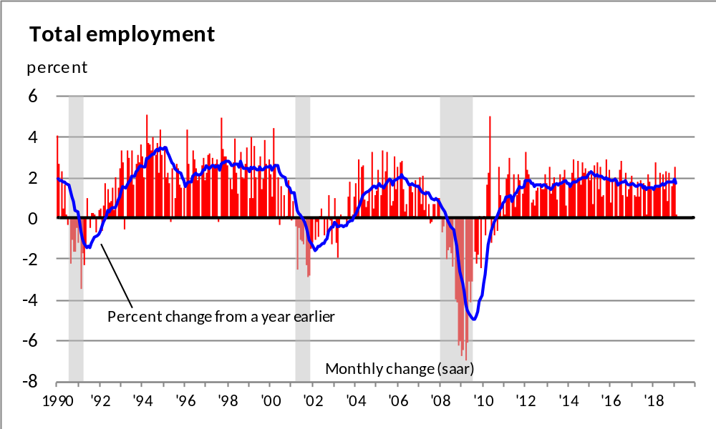
Employment increased by over 2.5 million jobs over the past 12 months

Slide 11
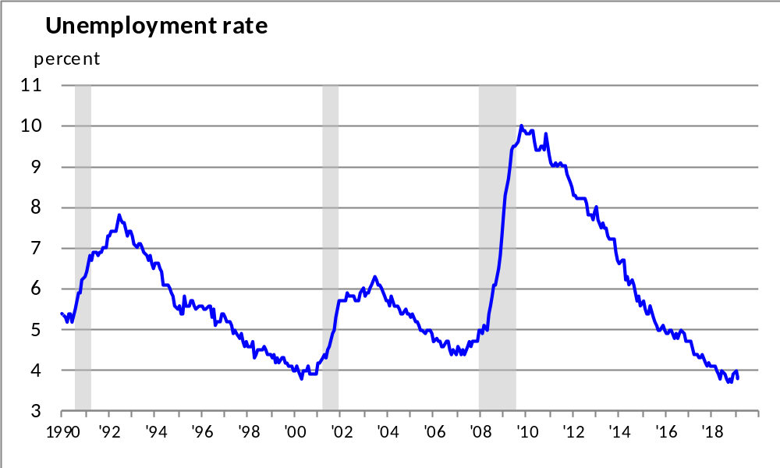
The unemployment rate is at 3.8%

Slide 12
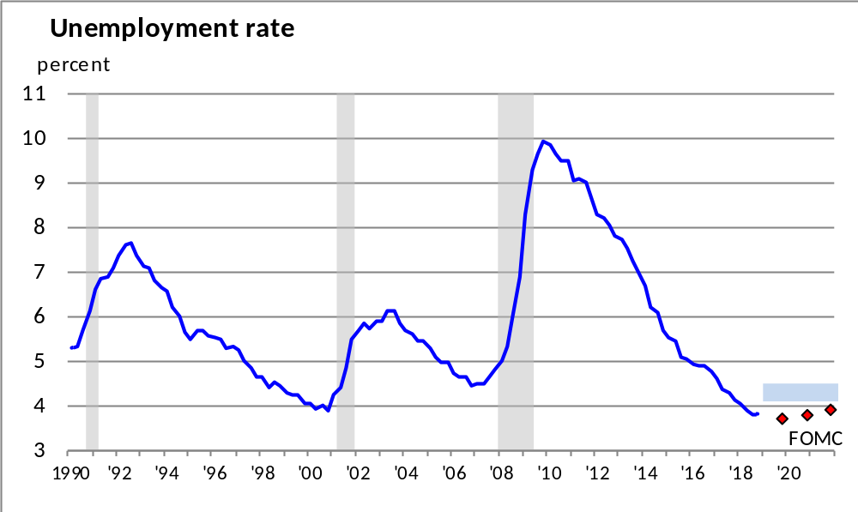
The FOMC forecasts that the unemployment rate will be below the natural rate through 2021
FOMC Central Tendency (March 2019)
2019 3.6 – 3.8
2020 3.6 – 3.9
2021 3.7 – 4.1
Longer run 4.1 – 4.5

Slide 13
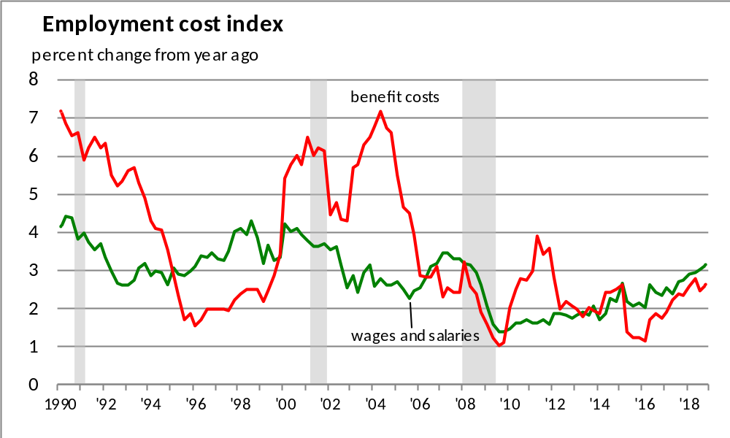
Wages and benefit costs continue to increase at a moderate rate, although it may finally be picking up some its pace

Slide 14
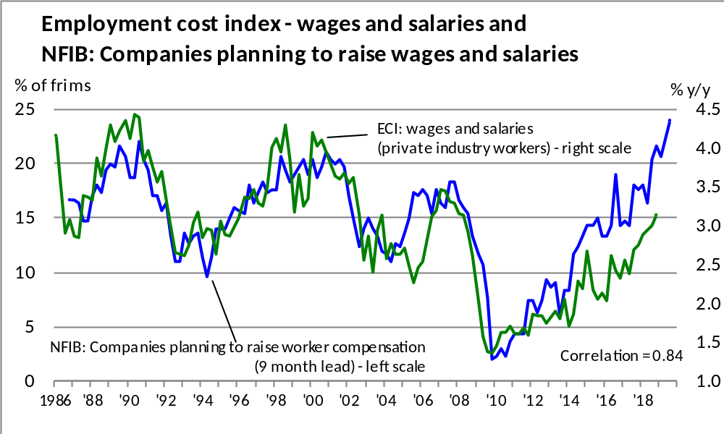
There is a very strong correlation between 9-month lead NFIB: planning to raise compensation and
Employment Cost Index: wages and salaries

Slide 15
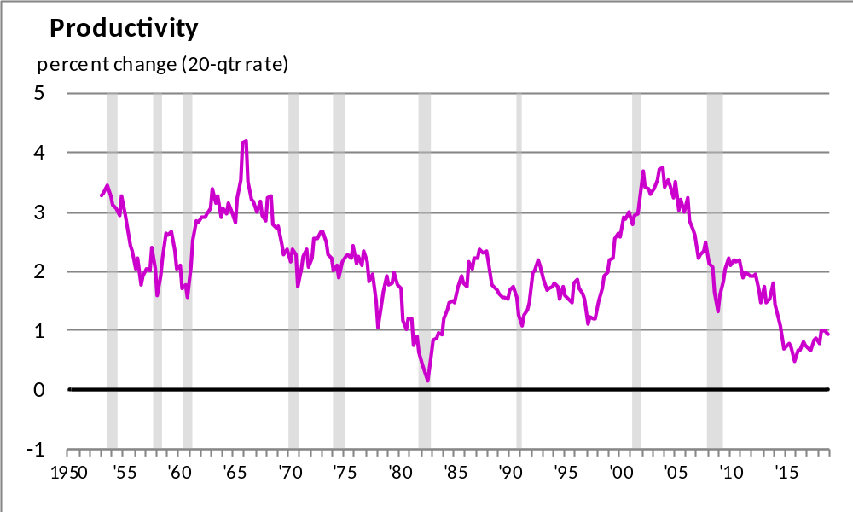
Slow productivity growth over the past nine years helps explain why relatively strong employment growth has not translated into higher wages

Slide 16
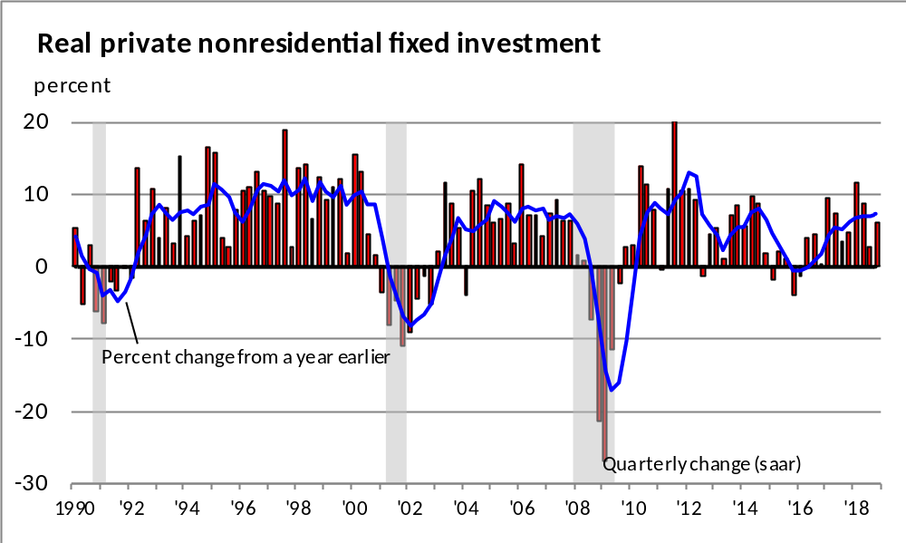
A large part of the weakness in productivity growth has been the weak pace of investment, although it has been increasing at a strong pace beginning in 2017

Slide 17
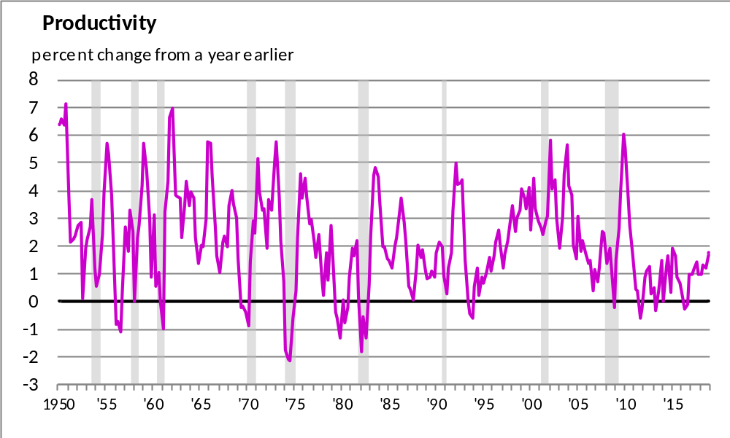
This may help explain the productivity growth improvement over the past year

Slide 18
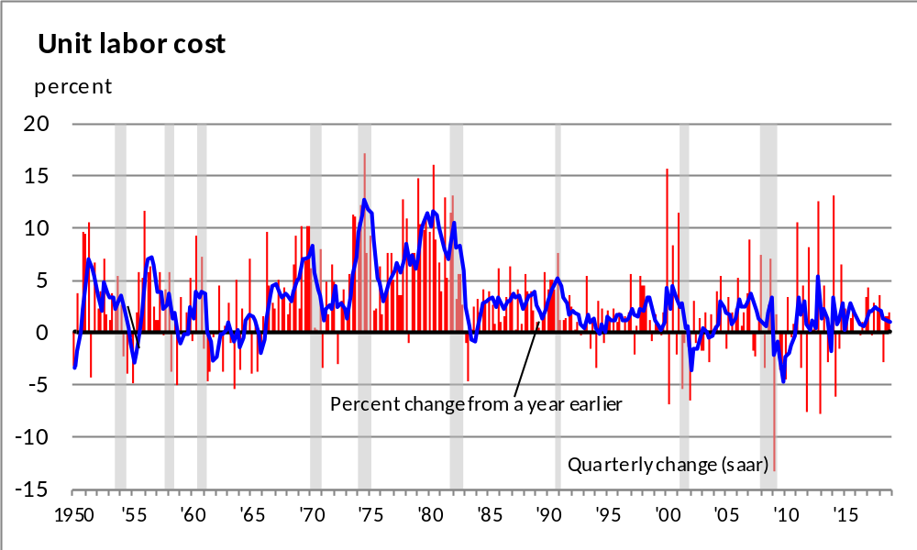
Improving productivity growth is helping to keep unit labor cost growth down even with compensation rising

Slide 19
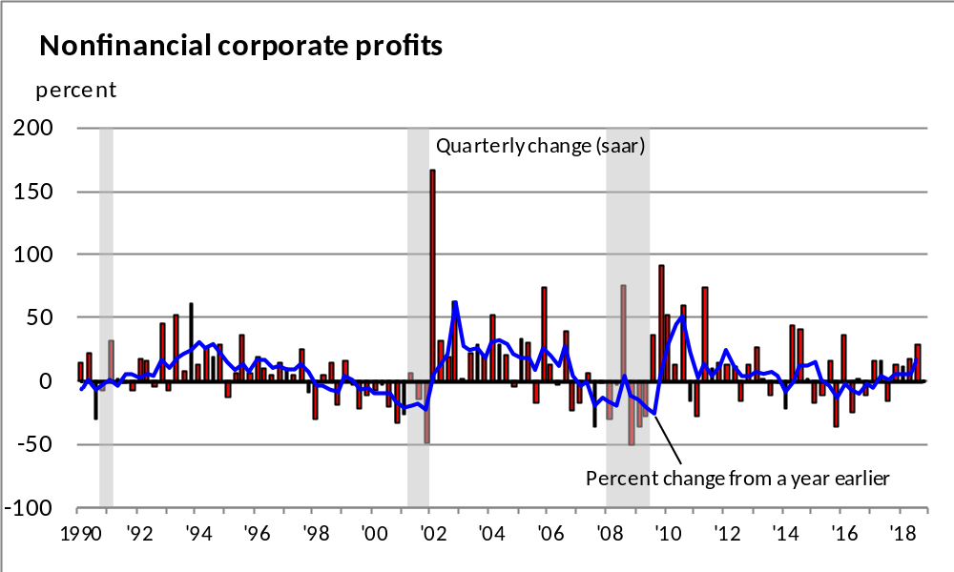
Corporate profits continue to improve

Slide 20
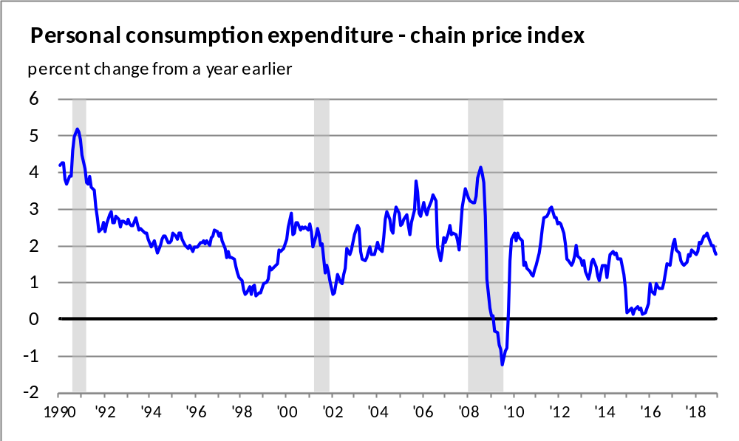
Inflation is just below the Fed target of 2%

Slide 21
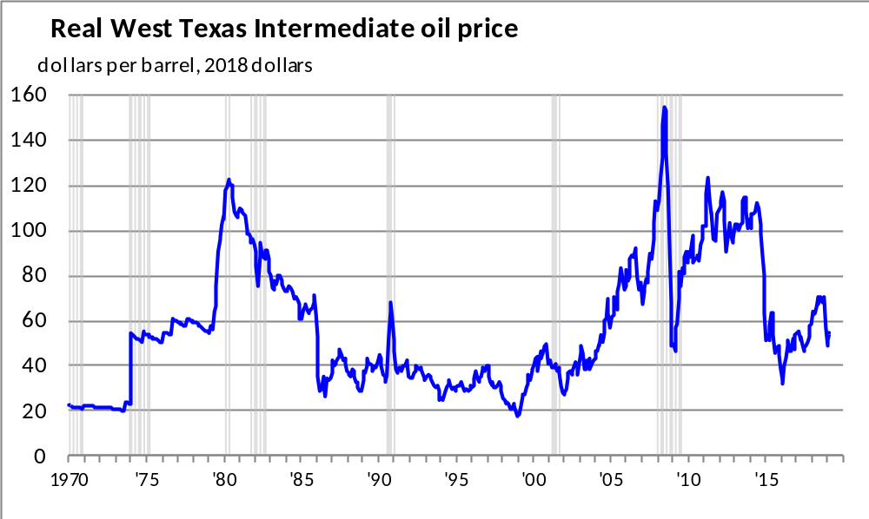
In large part inflation has been following the pattern of energy prices

Slide 22
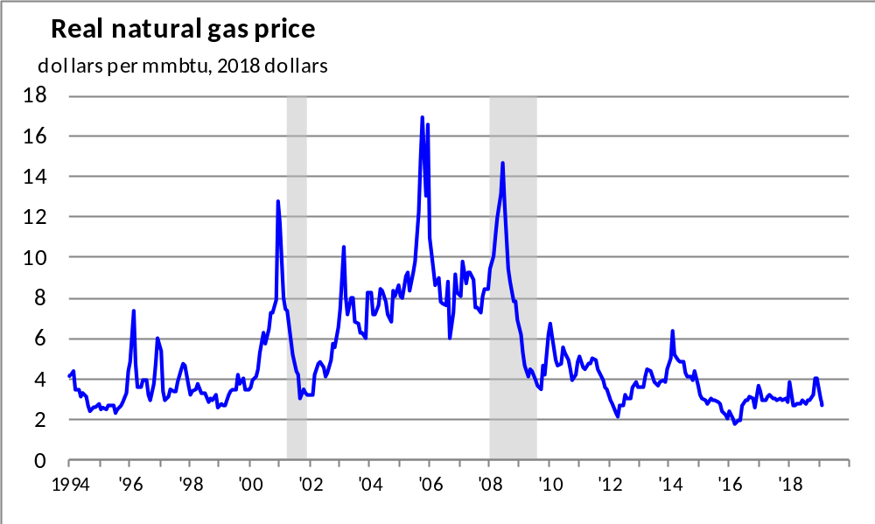
Natural gas prices have increased but remains low

Slide 23
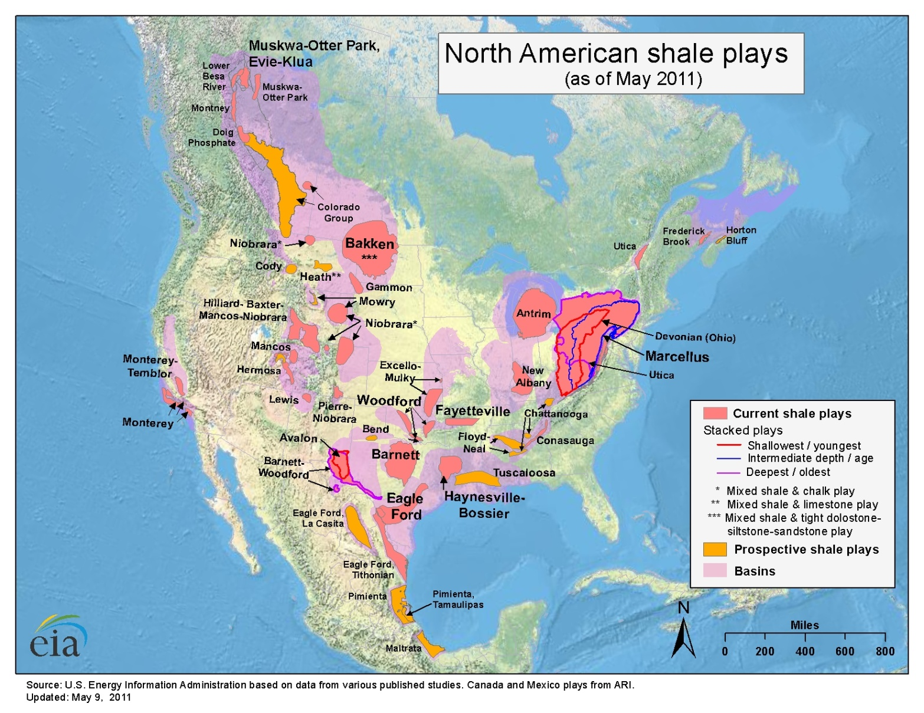
Low energy prices have occurred in part due to technology that now allows access to reserves that have been known for quite a few years

Slide 24
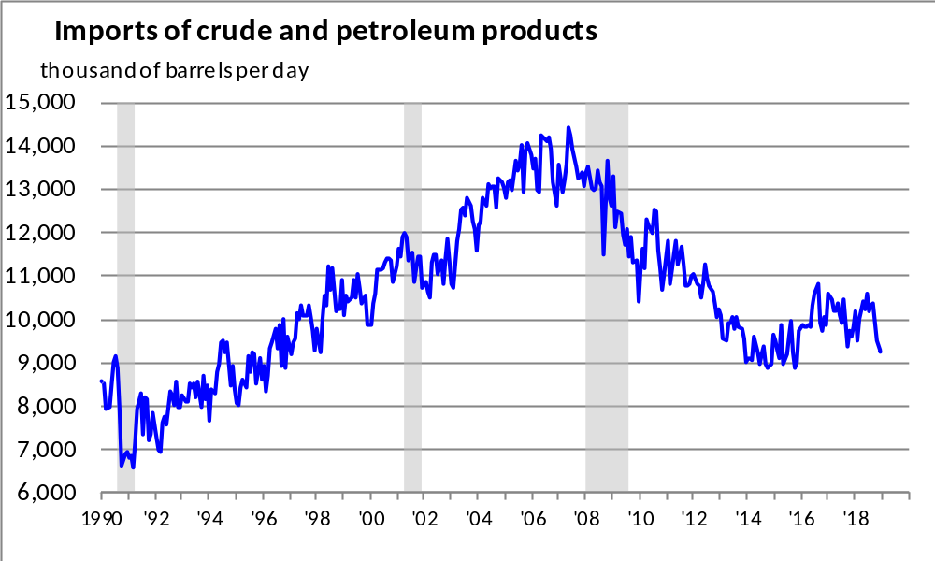
Imports of oil has been sharply reduced

Slide 25
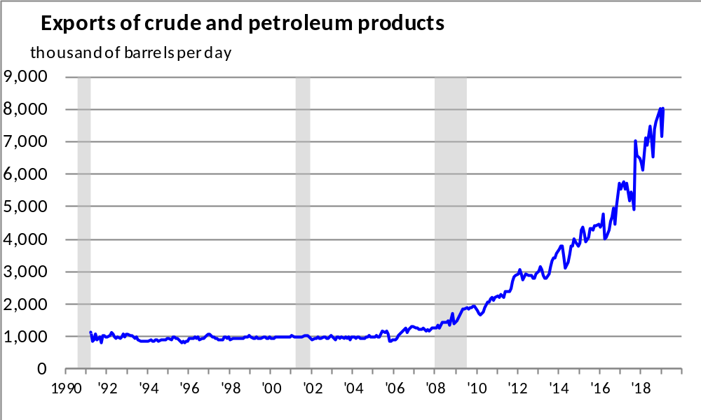
Exports of oil has surged over the past decade

Slide 26
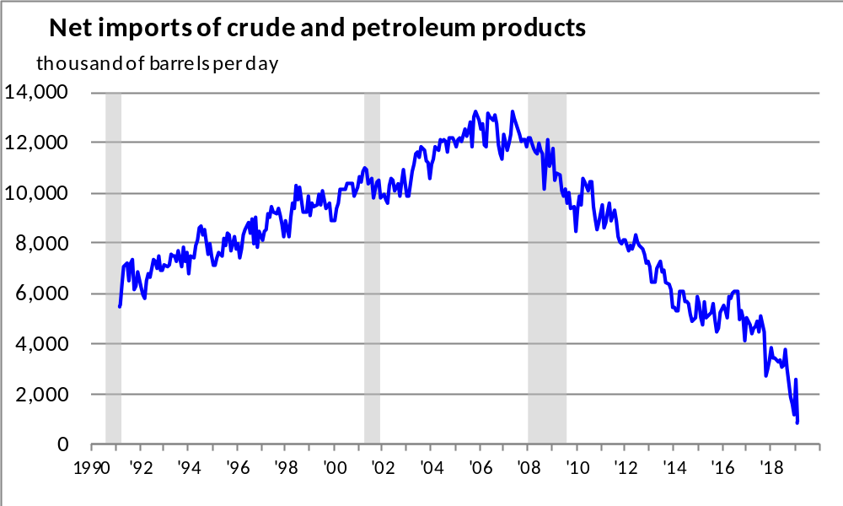
Net imports of oil has been cut by around 60%

Slide 27
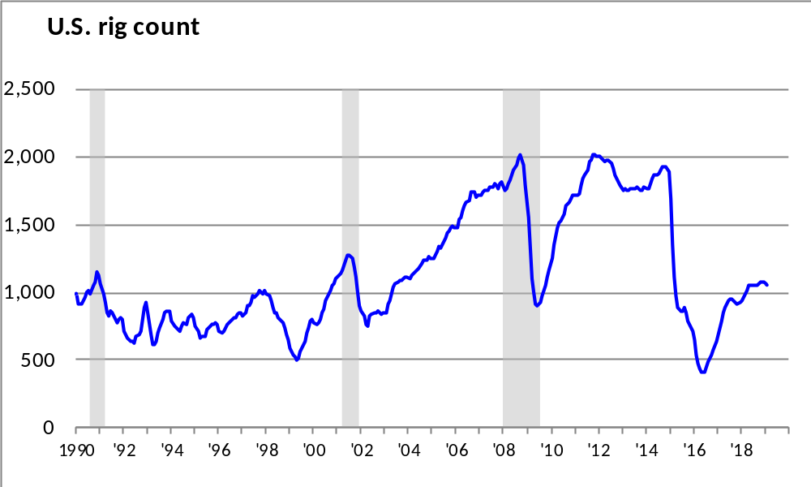
The rig count has been moving higher

Slide 28
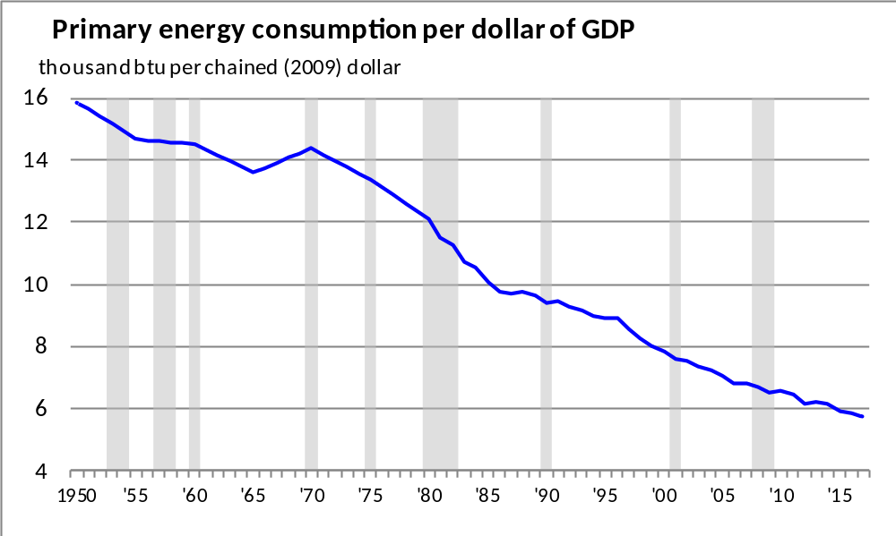
The U.S. has become less dependent on energy to drive its economy

Slide 29
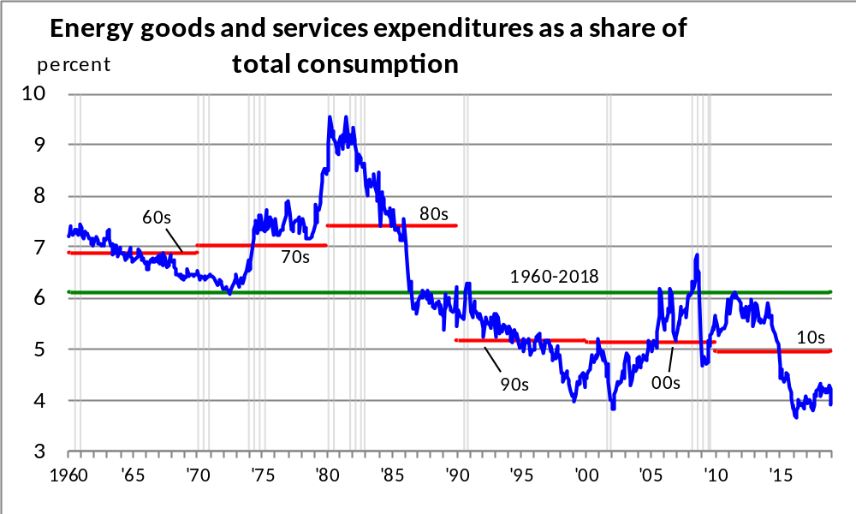
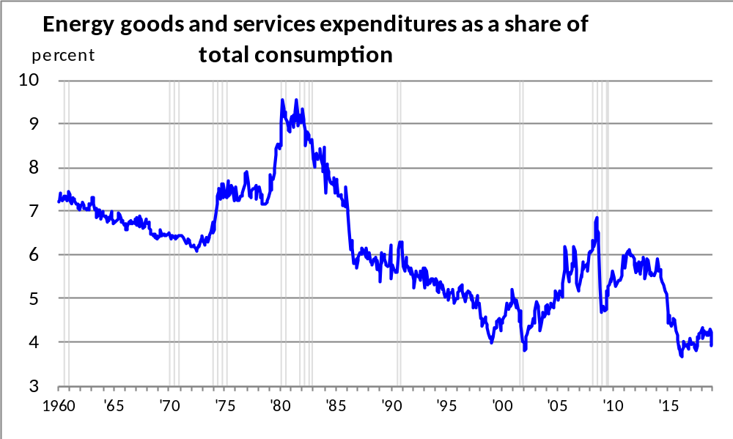
Expenditures on energy remain well below the historical average

Slide 30
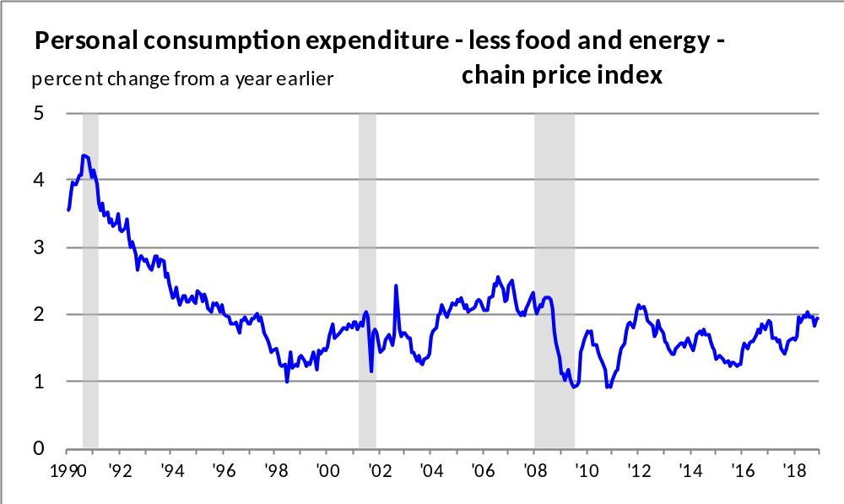
Removing the volatile food and energy components from the PCE,
“core” inflation is just below 2%

Slide 31
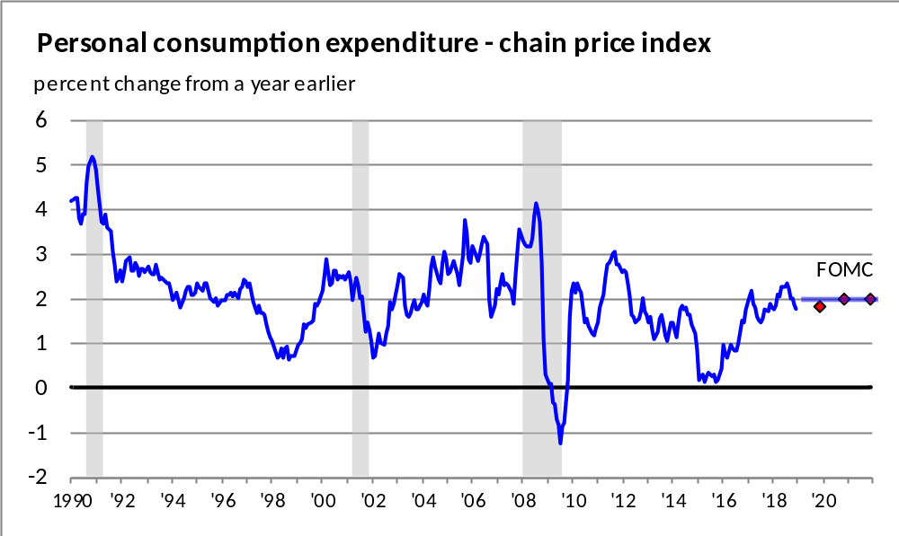
The FOMC anticipates that PCE inflation will be around its two percent target through 2021
FOMC Central Tendency (March 2019)
2019 1.8 – 1.9
2020 2.0 – 2.1
2021 2.0 – 2.1
Longer run 2.0

Slide 32
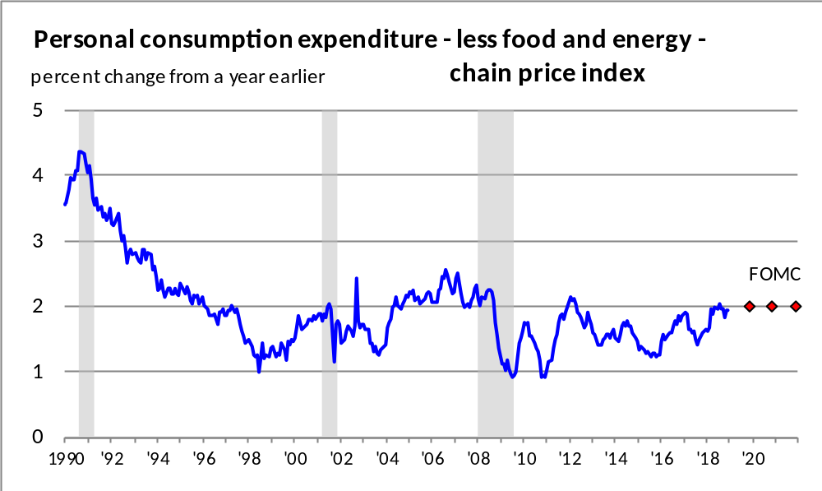
The FOMC anticipates that “core” PCE inflation will get to also remain around two percent through 2021
FOMC Central Tendency (March 2019)
2019 1.9 – 2.0
2020 2.0 – 2.1
2021 2.0 – 2.1

Slide 33
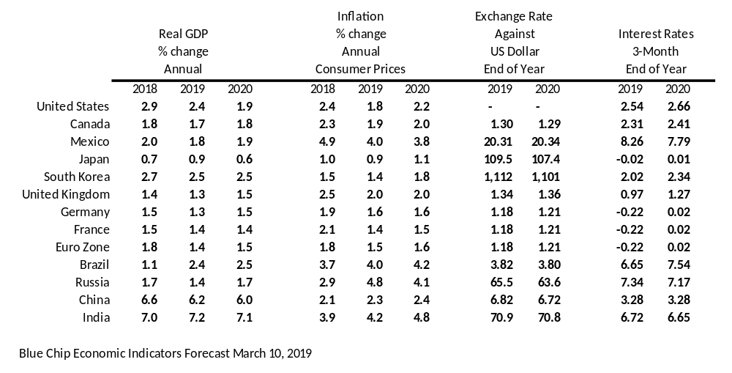
Blue Chip International Consensus Forecasts

Slide 34
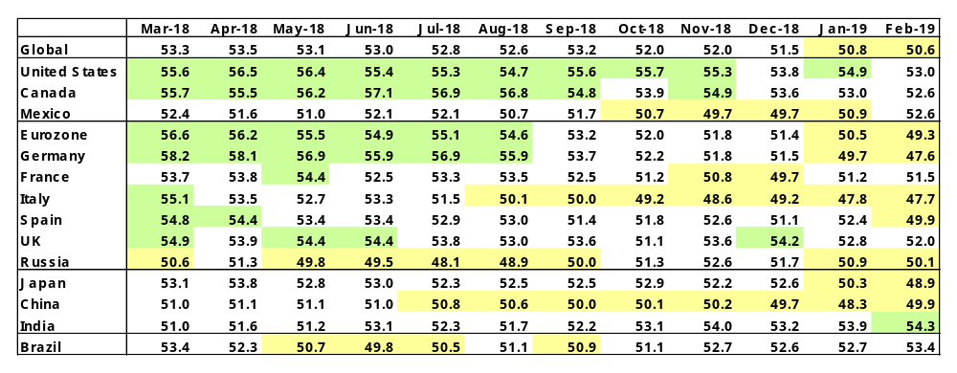

Manufacturers’ Purchasing Managers Indexes

Slide 35
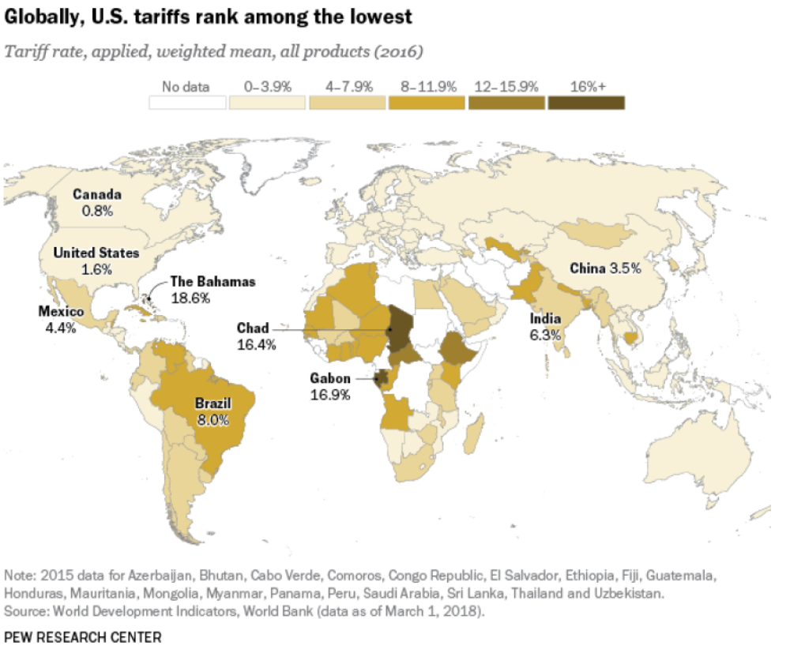
More open countries have had better growth

Slide 36
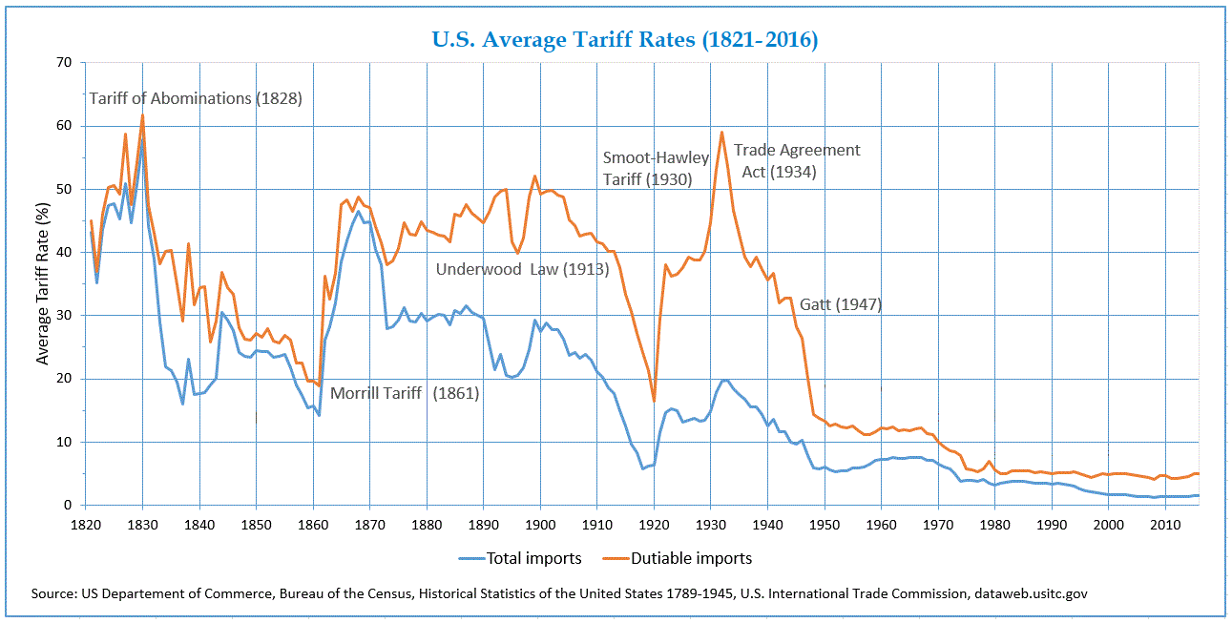
U.S. tariffs used to be much higher

Slide 37
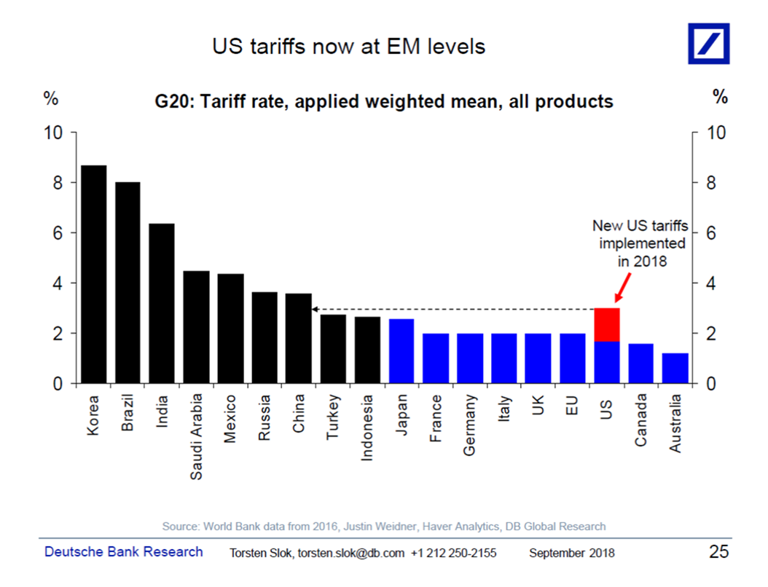
Tariffs: U.S. versus other countries

Slide 38
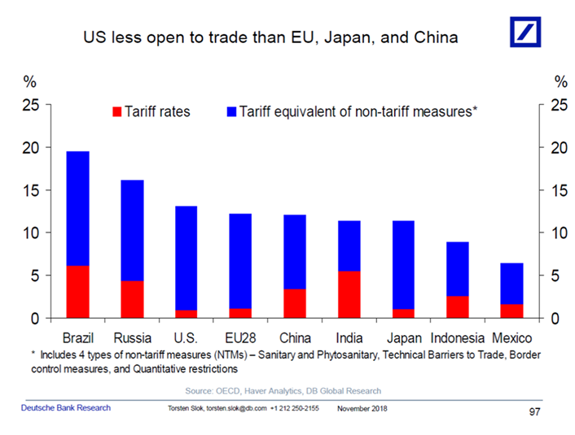
Tariffs: U.S. versus other countries

Slide 39
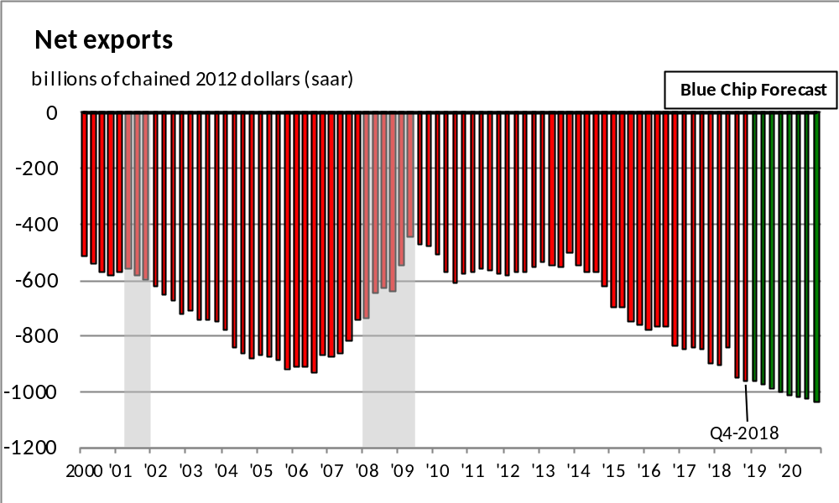
The Blue Chip forecast projects a continuing deterioration in the balance of trade

Slide 40
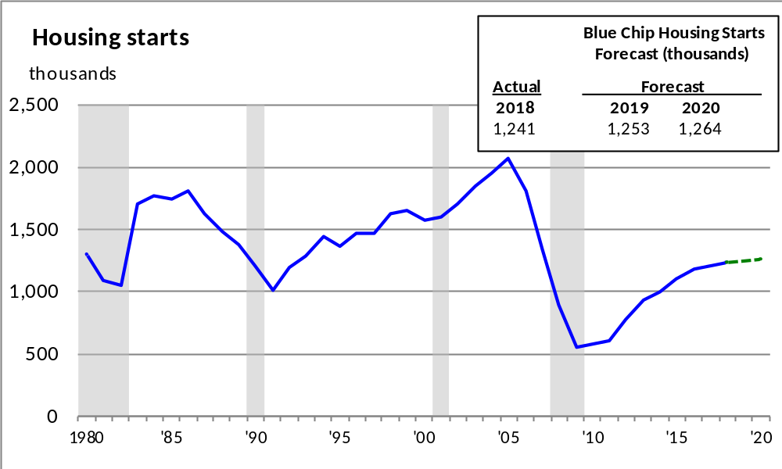
The Blue Chip Forecast calls for a continuation of the very gradual recovery in housing

Slide 41
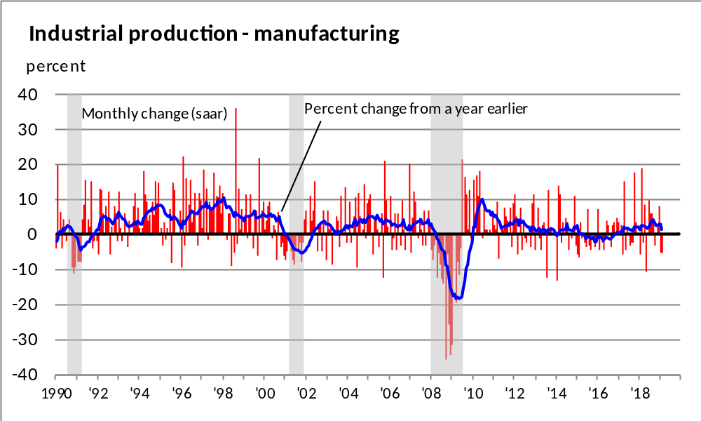
Manufacturing output growth has been slowing

Slide 42
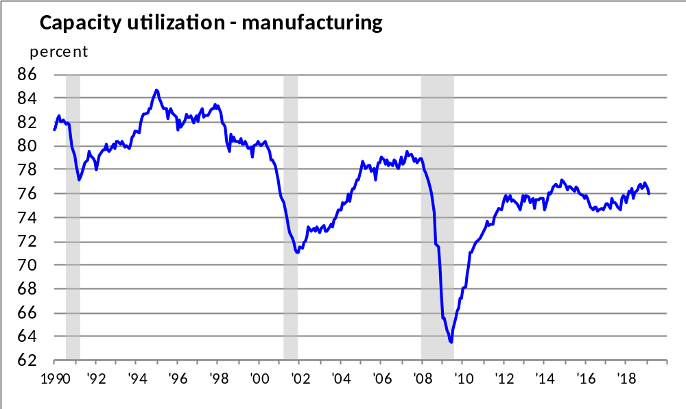
Capacity utilization has ticked lower and is still below full utilization

Slide 43
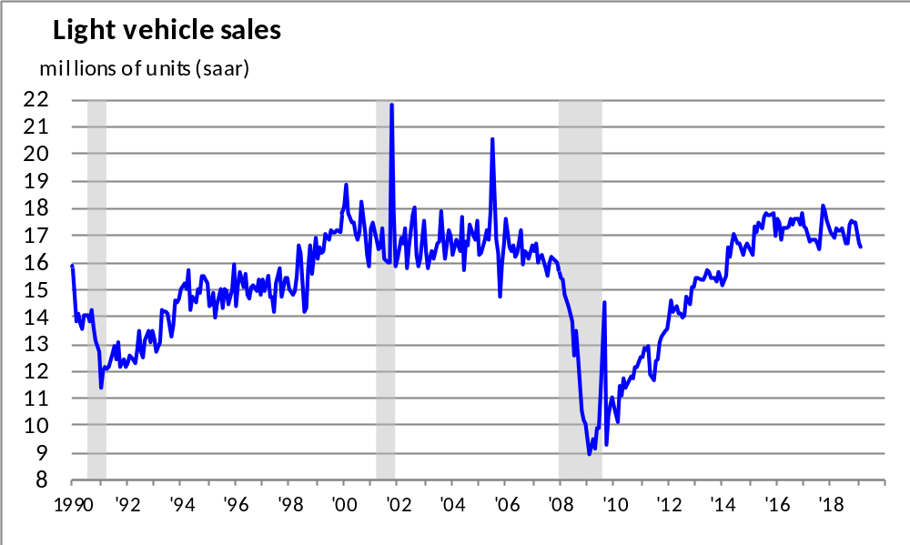
Year-to-date light vehicle sales are 16.6 million units in 2019,
2.4% below the comparable period from a year earlier

Slide 44
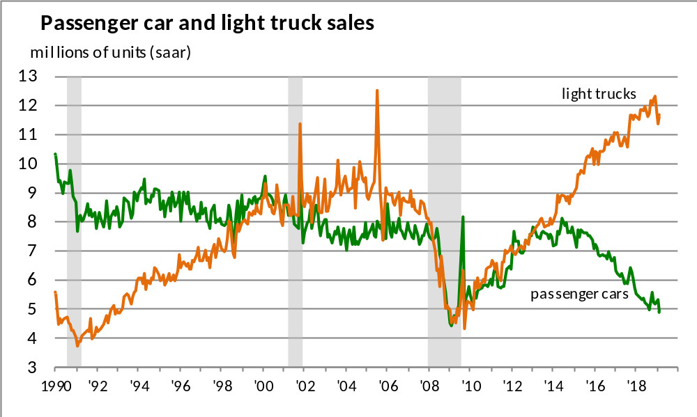
Year-to-date 2019 light truck sales were 0.3% lower, while year-to-date 2019 passenger car sales were 7.0% lower

Slide 45
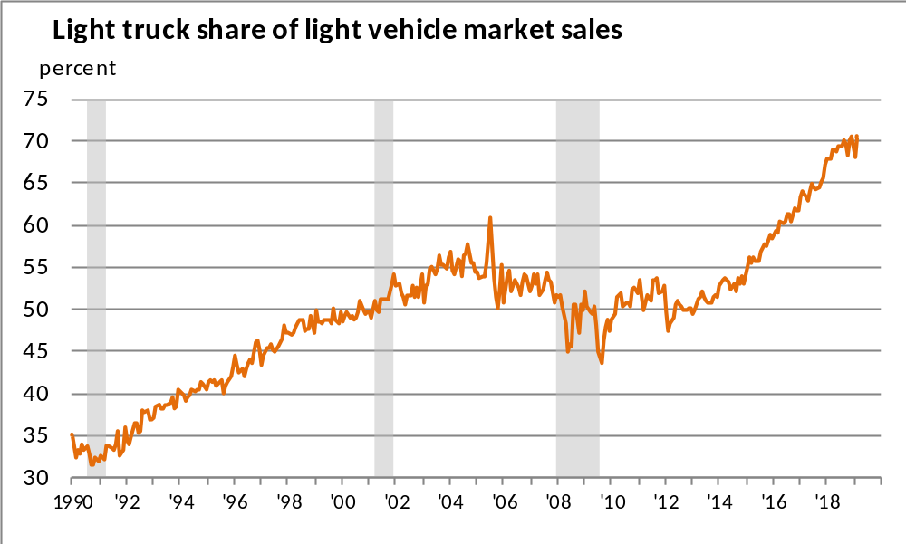
Light truck market share are at a record high

Slide 46
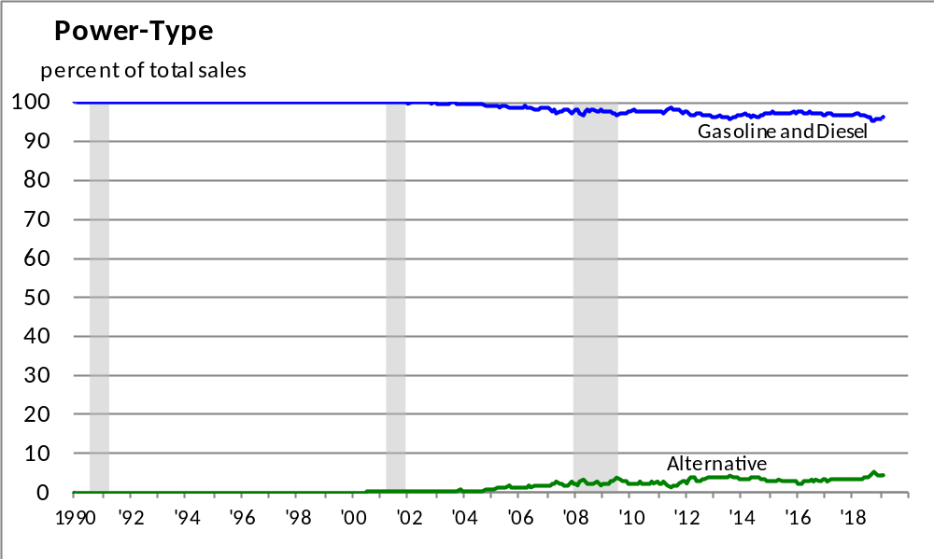
Alternative powered vehicles (including hybrids) are a very small fraction of total vehicle sales

Slide 47
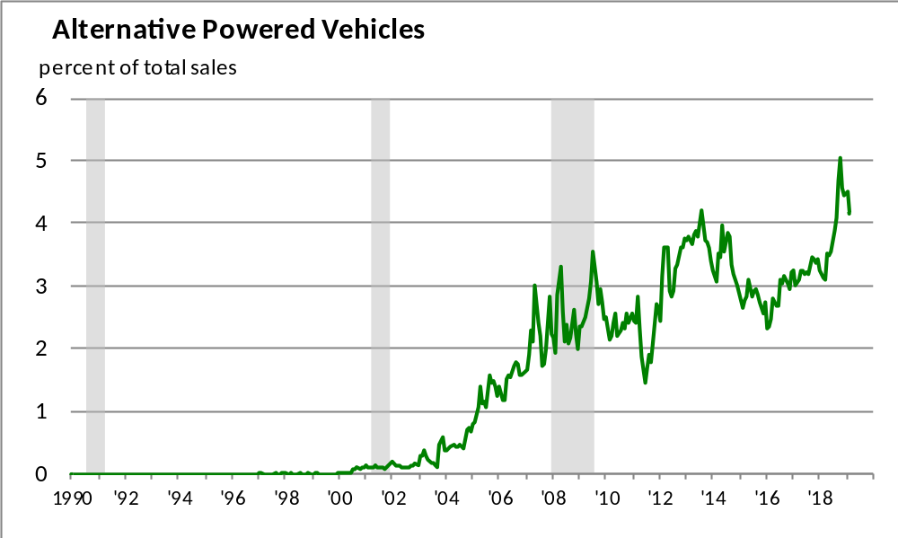
Alternative powered vehicles (including hybrids) market share is barely over 4%

Slide 48
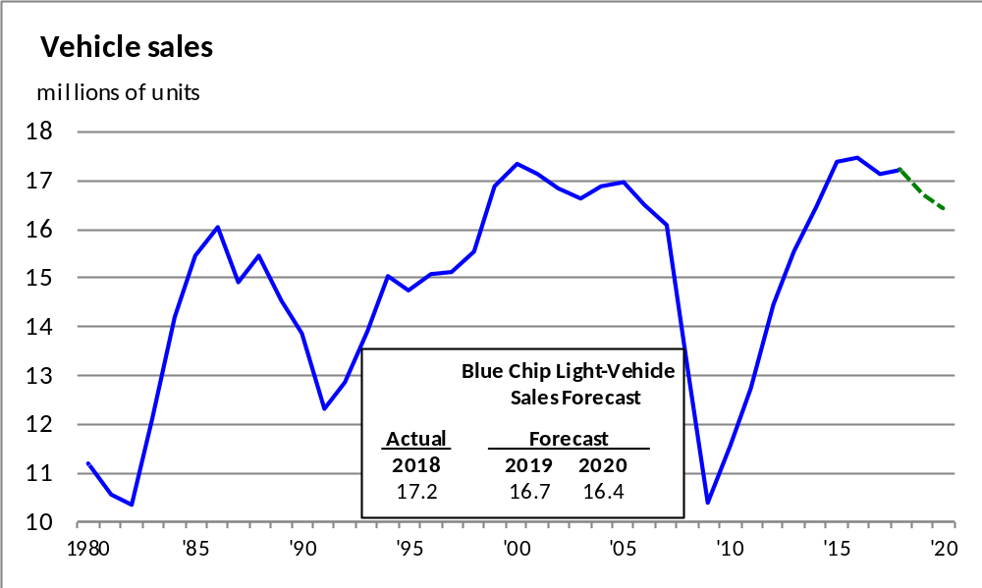
Blue Chip Forecasts vehicle sales to move lower this year and in 2020

Slide 49
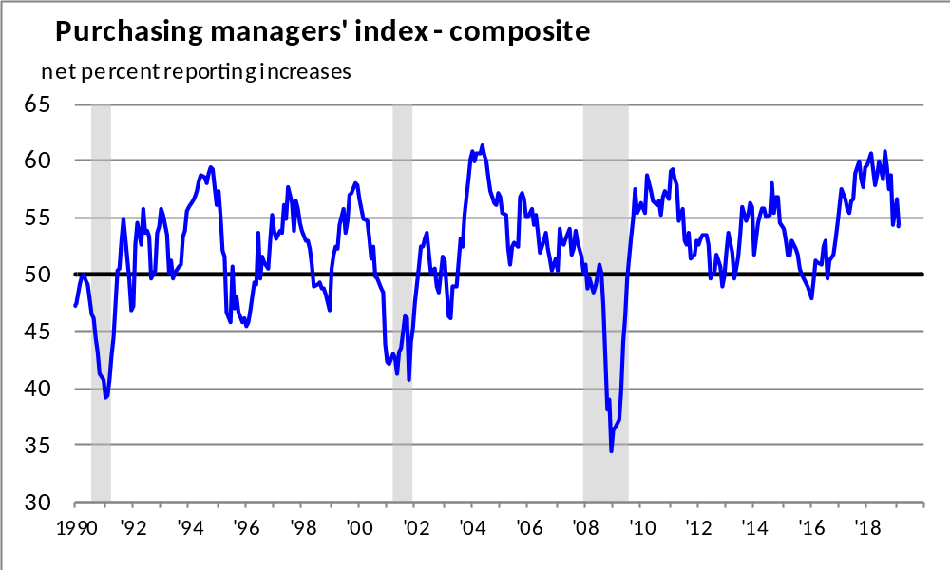
The supply managers’ composite index remains at a very solid level

Slide 50
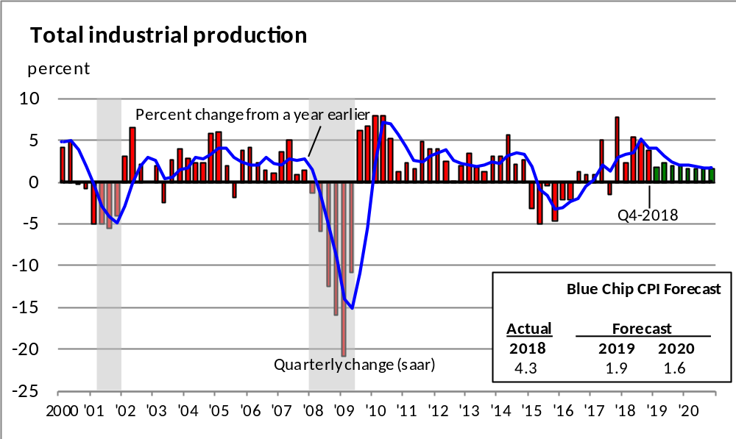
Industrial production is forecast to rise at a slower pace this year and moderate further in 2020

Slide 51
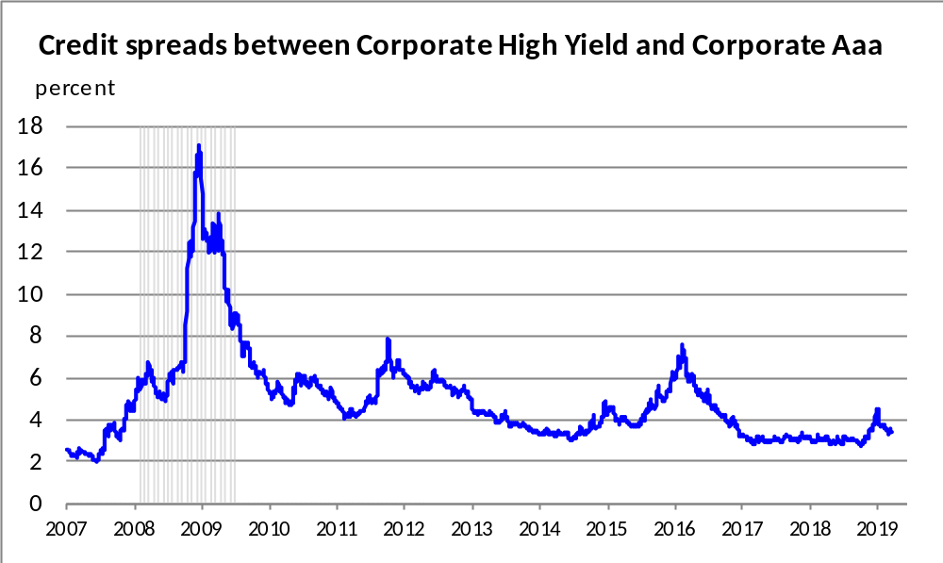
Credit spreads between Corporate High Yield securities and Corporate Aaa securities increased towards the end of last year, although it has pulled back this year

Slide 52

The yield curve continued to flatten but remains above zero

Slide 53

Blue Chip expects the yield curve to continue to flatten slightly more this year, but not invert

Slide 54

The Federal Reserve increased the
Federal Funds rate by 2.25% since December 2015

Slide 55

The Federal Funds Rate is expected to be just below the neutral range in 2019 and at the bottom end of the neutral range in 2020 and 2021
FOMC Central Tendency (March 2019)
2019 2.4 – 2.6
2020 2.4 – 2.9
2021 2.4 – 2.9
Longer run 2.5 – 3.0

Slide 56

The Fed’s balance sheet has been falling since October 2017 and will end the balance sheet reduction in September 2019

Slide 57
Summary
The outlook is for the U.S. economy to expand at a pace
just above trend in 2019 and close to trend in 2020 and 2021
Employment is expected to rise moderately with the
unemployment rate remaining very low
Inflation is forecast be at the Fed’s Inflation target through 2021
Housing is predicted to improve at a modest pace
Vehicle sales are anticipated to edge lower this year and in 2020
Manufacturing output is expected to increase at a somewhat
slower pace in 2019 and 2020

Slide 58

www.chicagofed.org www.federalreserve.gov

